Slide 1
HISTORY AND PERIODS OF TURKISH MUSIC

Slide 2
Turkish music history, which examines the relationship of Turks with music from the time when the Turks first emerged onto the world scene to the present day, is not a science that one can undertake in detail.

Slide 3
If history is considered to begin with writing, the interval during which the Turks have expressed themselves in writing covers only the last 1,500 years. Unfortunately, we do not have any sources relating to Turkish civilization of earlier periods. Consequently, both Turkish history, as well as our data on Turkish culture and arts, is extremely limited. Even if we disregard for a moment the difficulty of writing about Turkish music with no written records on the subject, as well as the dearth of sources, it behooves us to state here some other issues that are equally important.

Slide 4
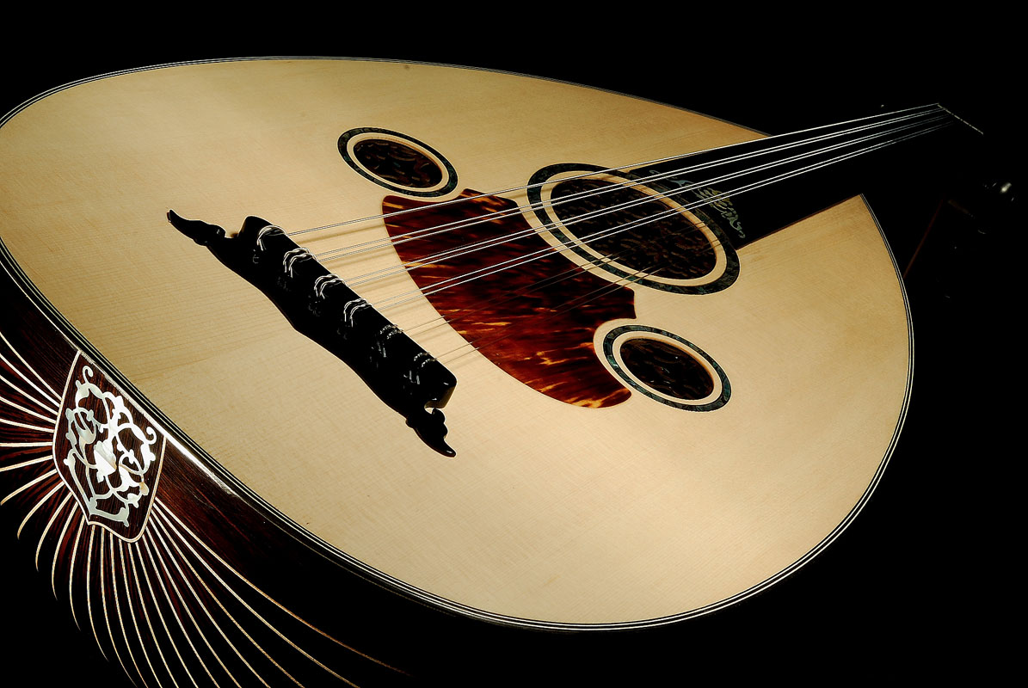

Slide 5
The Turks are a huge group of people living over a very wide geographical area, who have founded or lived within many and diverse states, with widely varying ways of life. When we speak of Turkish musical history, it an especially important that we know which Turkish tribe's music we are talking about, and from which period. Trying to understand the last eight hundred years based on the written sources on Turkish music, it is quite difficult to shed light on earlier periods.

Slide 6
But despite all these difficulties, the first information from some Chinese sources on the music of the old Uygurs and the Hatay (Hitay, Kutay) Turks - limited as it may be - has become available to us. Along with this, findings obtained in some archaeological digs in Central Asia give the evidence of a well-developed musical culture among the Huns, Göktürks and Uygurs.

Slide 7
These musical cultures are known to have included a variety of instruments, a unique notation system and a broad musical repertoire. As research of Turkish history is improved, our knowledge of Turkish music will improve in turn. Though one can say much about the roots of musical traditions alive in Turkey today, it is necessary to consider these together with their Asian roots, and take into account the interactions with other peoples in Anatolia.

Slide 8
Consequently, when we speak of Turkish music, the unique musical cultures of Turkish societies spread over various regions of the world come to mind, and the fact that these are musical traditions that exhibit different characteristics from one another. It is believed that in those ancient eras when there was no distinction between those who made and those who applied music; when the traditional sounds were reproduced within daily life, music was a sacred element.

Slide 9
Believing that the whole of these sounds, occurring when the sounds of nature were arranged one after the other, were magical, they imbued these sounds with special significance; and the performance of this music was the domain of certain special people. Serving their societies as religious figures, leaders, or magicians, these people, known by names such as Kam, Baksi, or Ozan, were musicians as well. These people carried out a religious as well as social function of music, and thus the whole of religion and social life were illustrated by music; similar voices brought forth the music of this life.

Slide 10
Because they had a migratory lifestyle until their arrival in western Asia, the instruments they used were always easily transportable. The tonal system of their music was designed parallel to this, with completely natural tones. In the early periods, tones in these systems were not arranged deliberately, there was no formal theory. But it certain features come to mind at the mention of Turkish music. One of these is that the vast majority of Turkish music is lyrical. Some musicologists qualify Turkish music as a lyrical music.

Slide 11
This is related to the lyrics' mission of uniting literature and music. Even when the Turks had no writing system, they had developed a great oral literature, the traces of which can be followed up until the present day in the epic tradition. This literature, containing traces of all aspects of social life, as well as philosophical, pastoral and didactic examples, is the result of the mission as well as the importance the Turks assigned to words.

Slide 12
Such a collection of lyrics, in order to achieve unity in society, and establish a tie between the generations of the tradition, brought with it an astounding repertoire. Music was used to accompany the words, in order to make them more moving, and more understandable. The instrumental repertoire comprises an extremely important but rather small section within this music.

Slide 13
The second important feature of Turkish music is that within all historically known periods, it has been a modal form of music. This system of modes, or makams, is known to have changed from time to time in relation to the makam system in use today. For example in Asia, a pentatonic musical system is still in use today. In western Asia, the closer one approaches Anatolia and the Balkans, the more the music is replaced by the familiar makam system.

Slide 14
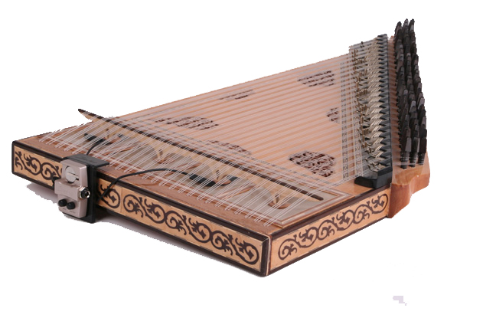

Slide 15
Traditional/local music
The Concept of Traditional Music: This is generally music that is created in a common manner, has continued from the time of its production right down to the present day, is popular and frequently played and recited in its region and by local people, and is usually anonymous. In Turkey, music that conforms to the above definition, which is produced by and located in a settled culture and which has thereby become traditional, can be classified as either ‘religious’ or ‘secular.’ These can also be considered under the headings ‘Folk/Local Music’ and ‘Ottoman Music.’ These two groups have many features in common, and can be classified as either ‘instrumental’ or ‘with lyrics.’

Slide 16
Folk/local music
These are forms of music created by people settled in one particular location, played or recited with great affection, which have become the joint creation of the people of the area in question, and which have been passed down and kept alive down to the present day. Such music bears the traces of local cultures, and the names of the composers are generally unknown.

Slide 17
Turkish folk music has combined the distinct cultural values of all those civilisations which have lived in Anatolia and the Ottoman territories in Europe. It is a unique structure which includes regional differences under one umbrella, giving rise to a wealth and variety the like of which can seldom be seen anywhere else in the world. Despite that wide variety from the point of view of regional characteristics, Turkish folk music can broadly be classified into the following seven regional categories:

Slide 18
One must nevertheless bear in mind, of course, that there may well be important differences between cities or areas within the same region.
Varieties of Style, Scale and Rhythm and Spheres of Use
Istanbul and Europe
Aegean
Central Anatolian Folksongs
Southeast Anatolian Folksongs
East Anatolian Folksongs
Black Sea Folksongs

Slide 19
Ottoman music
The form of music today generally known as Türk Sanat Müziği, or Ottoman Classical Music, matured, developed in form and aesthetics and came to assume the identity of a form of classical music in parallel to the establishment, growth and increasing strength of the Ottoman state itself.

Slide 20
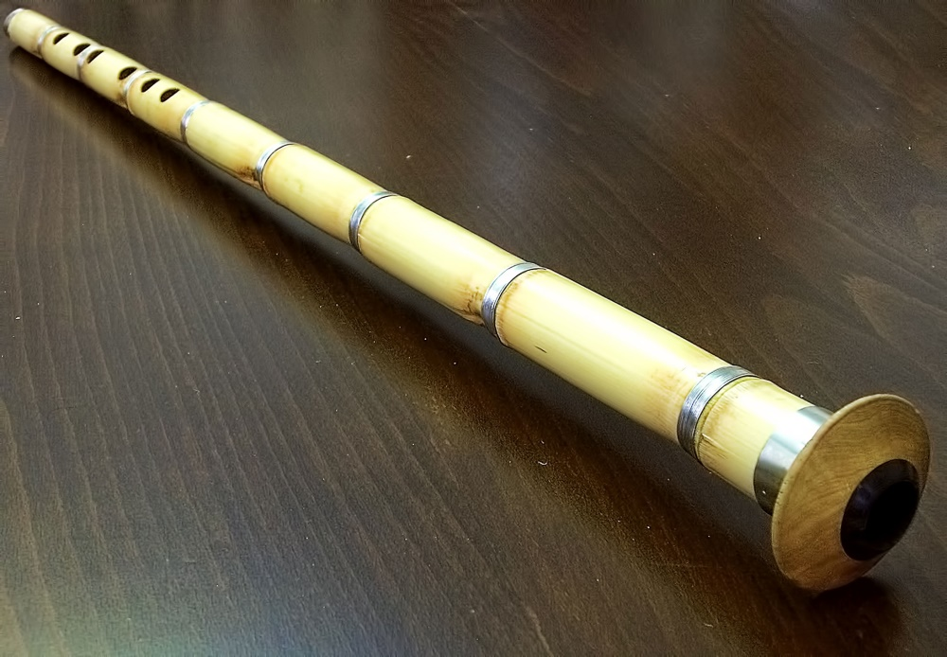

Slide 21
This variety of music furnished products dealing with many subjects, such as religion, love and war. Each of these then came to develop its own varieties, styles and communities. Ottoman music was influenced by other musical cultures as new nations became absorbed into the empire, giving and receiving various elements.

Slide 22
From the beginning of the 19th century, however, as the empire began to recede and collapse, increasing shallowness and laxness can be seen in Ottoman music. While rich modes and styles had been employed in the past, this concept gradually faded and turned into metropolitan entertainment music. That process has continued to the present day, and the ‘popular song’ has become increasingly popular and popularised, effectively taking the place of the other forms.

Slide 23
A great number of works were actually forgotten and disappeared as less importance was attached to notation in the middle of the 19th century. The number of works that were written down and have survived down to the present day is some 3,000 for works composed between the 15th century and the end of the 18th.

Slide 24
The number produced during the 19th century is around 5,000, giving a total of 8,000. A number of works from the first quarter of the 20th century can also be added to those works, which from the point of view of mode, style, means and methods of vocalisation go back to the very earliest times within a framework of their own distinct rules. Ever since then, the music that has continued to be produced under the name of ‘Turkish Classical Music,’ and which has grown ever more popular, can be seen as an extension of Ottoman music adapted to present-day norms.

Slide 25
Ottoman music is a synthesis, carrying within it a great many historical riches. It emerged as the result of a sharing process between the Turks and the minorities living alongside them, the Byzantines, Greeks, Persians, Arabs, Jews, Armenians etc. It reached its golden age in the private school in the Ottoman palace. No country that employed that system was able to reach the level of artistry attained by the Ottomans.
Ottoman music was formed and given voice in the ‘Fasıl,’ itself based on unity of mode.

Slide 26
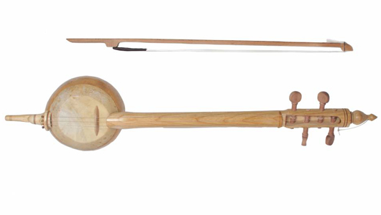

Slide 27
Fasıl; Works composed within the same melodic structure (makam) , or mode, set out and played in a particular order. In a genuine fasıl, there will be works for voice and for saz. The basis of the fasıl is that the works should have the same melodic structure, and they are then ordered according to shape or form. There must generally be two ‘Beste’ (poetic forms) and five ‘Semai’ composed to count as a complete fasıl. These are accompanied by lyrics.

Slide 28
The compositions are in the form of ‘Murabba’ (a poem composed of quatrains) or ‘Nakış’ (a form of song). Murabbas are composed for two rhyming couplets of a ‘Gazel,’ and may be with or without ‘Terennüm,’ which are words that complement the verses that make up the formal lyric of the song, and may either have a meaning or else be just a string of syllables, for example ‘ten, tenen, tenenen, ten nen ni.’ Lines 1, 2 and 4 of the poem are tied to the same melody, with line 3 having a different melody. This latter section is known as ‘Miyan Hane,’ wherein the makam is either widened or changed. Murabbas with terennüm repeat it at the end of each line. The terennüm of the miyan hane may be different, however. In the nakış, on the other hand, two verses are read together, followed by a lengthy terennüm

Slide 29
Semai with lyrics and the same structure as the murabba or nakış (but composed in the semai style) are known as ‘Ağır’ and ‘Yürük’ Semai respectively. In the fasıl, lyrical works such as the ‘Kar’ or ‘Şarkı’ and instrumental pieces such as ‘Taksim,’ ‘Peşrev,’ ‘Saz Semaisi’ and ‘Oyun Havası’ may be added. In this way, the structure of a complete fasıl is as follows;
a) Any introductory Taksim with saz. b) Peşrev c) The first beste or kar. d) Second beste. e) Ağır semai f) Şarkıs (in order from major rhythmic pattern and slow character, to minor and fast) g) Yürük Semai h) Saz Semai

Slide 30
The ‘Kar’ gives considerable space to the terennüm component, and is a work with lyrics requiring considerable expertise. It is one of the most developed forms. The ‘Şarkı’ in Turkish literature is a form that emerged under the influence of the folk song. The şarkı consists of lines of verse, its name depending on the number of verses involved. It is composed with a minor rhythmic pattern (usul) and take can take various forms.

Slide 31
It was particularly popular after the 19th century, and left the other forms which included lyrics in the shade. It went from strength to strength in the 20th century, going beyond the previously established frontiers and eventually turning into the ‘Fantezi’ form as it grew more and more popular. Apart from a few outstanding examples, it played a major role in restricting the sphere of traditional classical music. The following are the form of instrumental pieces employed in Ottoman music;

Slide 32
Peşrev: Generally composed in major rhythmic patterns, such as ‘Darb-ı Fetih,’ ‘Sakil,’ ‘Muhammes’ and ‘Devr-i Kebir,’ or sometimes in minor ones, such as ‘Düyek.’ It is a saz work that emerged from the sections called ‘Hane’ and the ‘Mulazime’ section that comes between and is repeated with little change.

Slide 33
Saz Semaisi: Although they have the same structure as the peşrev, the saz compositions falling in the semai (six-time), ‘aksak semai’ (10-time) and yürük semai (six-time) categories are known as ‘Saz Semaisi.’ These come at the end of the fasıl, following the yürük semai.

Slide 34
Taksim: Intended to introduce, prepare the way or warm up for the makam, these are played with a single instrument, within the makam, yet not linked to any rhythmic pattern, and are either free-form or improvised.
Oyun Havası: Instrumental pieces composed for dancing.

Slide 35
Usul: Up to 15-time these are known as ‘Küçük Usul’ (minor pattern), and after 15-time as ‘Büyük Usul’ (major pattern). When the two are employed together, this is known as ‘Darbeyn.’ There are also strings that use one usul after another. One of these consists of five usul, either 60 or 120-time, depending on which view one adopts, and this is known as ‘Zencir.’ Kücük usul in 5, 7, 9-time etc. or 10-time works such as the aksak semai, are known as ‘Aksak Usul.’ The true times that bear the name ‘aksak’ are usul in 2+2+2+3 form.

Slide 36
Janissary (mehter) music
In the Turkish tradition, janissary music is a sign of majesty, splendour and might, rather than a vehicle for merriment. The majestic and sacred nature of the state are reflected in the banging of the drum. The unity of the people and the greatness of the state are particularly important concepts in the Turkish view of the nation. This belief and tradition was also to be found in the pre-Islamic Turkish states, and those of the Seljuks and the Ottomans, and very little has since changed.

Slide 37
There are three important symbols in this framework:
The ‘Otak’ was a large pavilion or tent housing the ruler or commander in chief. It emerges as a symbol of war, since it was only erected in times of conflict.
The Ruler’s Drum (Kös) – This large drum stood in front of the ruler’s tent and belonged solely to him. The ruler’s Janissary Band (Mehter) play under the standard and before the tent in order to instil courage into the troops.

Slide 38
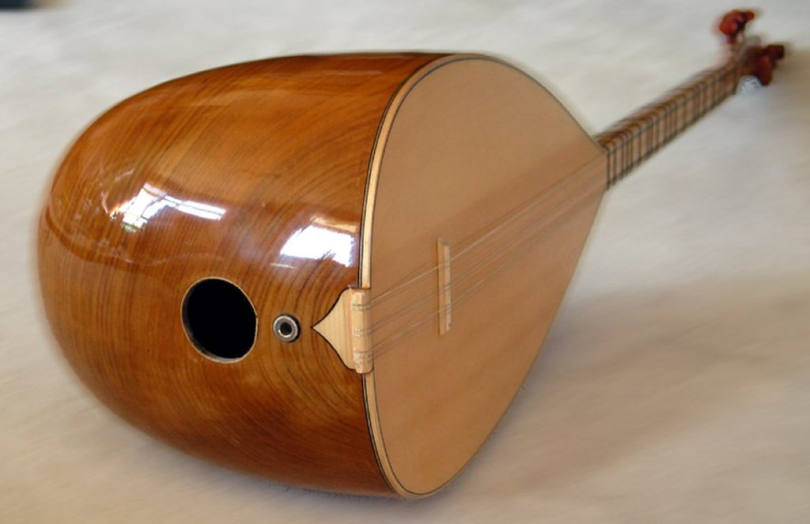

Slide 39
The standard and the band were two inseparable components of the Turkish state. The beat of the mehter accompanied the leaving of the tent and the first steps to war. In the Central Asian Turkish tradition, the banging of the big drum in front of the ruler’s pavilion on certain specified days in order to demonstrate his power was known as ‘beating the nevbet.’ This was regarded as a means of demonstrating the ruler’s might to friend and foe alike, and was particularly intended to strike fear into the hearts of the enemy.

Slide 40
The mehter was no less sacred to the Ottomans than the standard. As well as representing independence and the existence of the state, the mehter also encouraged martial feelings with uplifting airs during battles, sieges and naval engagements. It would not only raise the morale of the Turkish troops and fill them with enthusiasm for the fray, but also instill a feeling of terror and defeatism into the foe. During battles, just a single ‘kös’ formed a mehter of its own. The drum would signal the attack or the halt. The mehter was composed of drums and pipes, and would lead the army to war.

Slide 41
The plundering of the mehter was regarded as a sign of military defeat. That meant that even the most terrible conflicts took place in the framework of the standard and the mehter. As well as being a military band during times of war, the mehter’s musical aspect came more to the fore in times of peace. When there was peace, the mehter was a sign of the ruler’s sultanate and the continued existence of the state. Drums and mehter also served the purpose of spreading news and announcements on behalf of the state.

Slide 42
The Ottoman mehter contained wind instruments such as the zurna (similar to the oboe), the boru (bugle), the kurrenay and the mehter whistle. It also contained such percussion instruments as the kös, the drum, the nakkare (a small kettledrum), the zil (cymbals) and the çevgan. The number of instruments was kept equal, which determined the total number of instruments used. For example, the largest and most important mehter, the Sultan’s Mehter or ‘Tabl ü alem-i hassa,’ consisted of nine of each instrument. In later periods, the number of instruments could be as high as 12 or even 16.

Slide 43
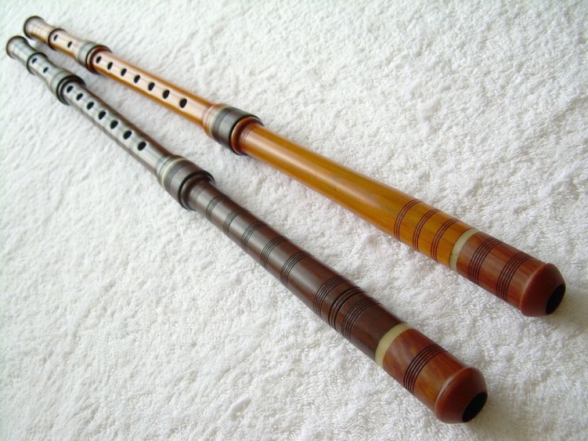

Slide 44
. As well as the sultan’s own mehter band, the grand vizier (equivalent to the prime minister), ordinary viziers (equivalent to cabinet minister rank), the defterdar (head of the Treasury) and the reisü’l küttab (in charge of the state’s foreign relations) would also have their own, and other bands were to be foundd in various provinces and castles.
The Europeans were impressed by the influence of the mehter, and military bands modelled on them were established in a number of countries. We also know that such composers as Gluck, Mozart and Beethoven were also inspired by mehter music.

Slide 45
Religious music
In the framework of music, the forms of music that accompanied or assisted such Islamic obligations as circumcision, fasting and the call to prayer, and known as Mosque Music or Dervish Lodge Music depending on where it was played, can all be considered under the single heading of Religious Music. Forms such as ‘tilavet’ (reading the Kuran), the ‘ezan’ (the call to prayer), and the ‘temcid’ (a call praising Allah chanted by the muezzin immediately after the morning call to prayer during the months of Rajab, Şaban and Ramadan) all fall under the category of mosque music. During the religious dancing or ceremonies practiced by a number of religious sects, especially the dervishes (Mevevi) and Bektaşi, come under the general heading of Mystical Music.

Slide 46
Traditional/Local Musical Instruments Cordophones (stringed instruments)
The sound from these instruments is produced by the vibration of the strings. These may be classified into two groups:
Bowed stringed instruments:
For example: The kemençe (small violin played like a cello), Kabak Kemane (ıklığ) (three-stringed violin), violin etc.
Plucked stringed instruments: For example: Ud (lute), tambur (like a mandolin), çeng (primitive harp), tar, kanun (like a zither), santur (dulcimer), kopuz (like a lute), the bağlama family (with three double strings and two necks) – meydan sazı (largest of the saz family), court saz, bozuk (nine stringed lute), tambura, cura, üçtelli (three-string), onikitelli (twelve-string), çarta, ırızva etc.

Slide 47
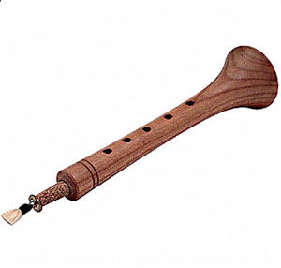
Aerophones (Wind instruments) Instruments whose sound comes from the vibration of the air in or around them.
For example: Zurna (like an oboe), çifte, mey (small oboe from eastern Anatolia), kaval (flageolet), sipsi (şile a boatswain’s pipe), çığırtma (small fife), tulum (bagpipe), harmonica, accordeon, mouth organ etc.

Slide 48
Membranophones (Skinned ınstruments) Instruments that produce their sound from the striking of a skin. For example: Dümbelek (small drum) (deblek, darbuka (drum made by stretching a skin over a clay cylinder)), davul (drum), daire (tambourine), def (tambourine with cymbals), kudüm (small double drum), zilli def (stringed def) etc.

Slide 49
Ideophones (Instruments that strike their own bodies) These are instruments played by means of striking, beating, waving etc. And are usually made of hard materials, giving off sound by the vibration of their entire bodies. For example: Zil (cymbal), maşa (fork), çalpara (castinets), şakşak (the spoons), çan (bell), çengizli (cymbalet), band bells etc.

Slide 50
GTO
FINE ARTS
HIGH SCHOOL
2016

